Slide 1

Master of Science in Analytics (MSA)
Dr. James Davis, Director
Stephenson Department of Entrepreneurship and
Information Systems
E.J. Ourso College of Business
Louisiana State University
Spring 2018

Slide 2
Agenda:
Why Offer the MSA?
What is the MSA?
Company Sponsors
Employment and Academic Successes
Project Descriptions
Graduate Certificate in Analytics
Application Process

Slide 3
Why Offer the MSA?
TOP 10 BUSINESS PRIORITIES | TOP 10 TECHNOLOGY PRIORITIES
Increasing enterprise growth | Analytics and Business Intelligence
Delivering operational results | Mobile technologies
Reducing enterprise costs | Cloud computing
Attracting and retaining new customers | Collaboration technologies
Improving IT applications and infrastructure | Legacy modernization
Creating new products/services (innovation) | IT management
Improving efficiency | CRM
Attracting and retaining the workforce | Virtualization
Implementing analytics and big data | Security
Improving business processes | ERP Applications
Worldwide Survey of CIOs, Gartner Jan 2013

Slide 4
Why Offer the MSA?
The No. 1 job in America pays over $100,000 a year
As companies try to understand consumer behavior, data scientists are in high demand. Boasting a median base salary of $110,000 and a job-satisfaction score of 4.4 out of 5, data scientist was ranked No. 1 on Glassdoor’s “Best Jobs in America” list in 2016, 2017 and 2018.
https://www.msn.com/en-us/money/careersandeducation/the-no-1-job-in-america-pays-over-dollar100000-a-year/ar-AAsirZd

Slide 5
What is the MSA Program?
1-Year Program (6th Year)
Summer (3) Fall (5), Spring (5) Semesters
36 Credit Hours (R, Python, SAS workshops)
Full-Time, Part-Time, & Online
Work on Projects with Company Sponsors
Student groups submit proposals and are selected on a competitive basis
Certifications

Slide 6

What is the MSA Program?
Summer | Fall | Winter
 | Datamining / Database | Adv Data Management
Advanced Statistics | Multivariate Statistics | Time Series Econometrics Statistical Modeling
Data Mining | Non-linear Models & Survival Analysis | Healthcare Analytics CSC 4740 (Big Data Technologies) Supply Chain Analytics
SAS Programming | Operations Research | Special Topics
 | Real-world project | Real-world project

Slide 7
Companies Sponsoring Projects
All Star Automotive (6) Shell Corporation
Blue Cross Blue Shield La (5) The City of New Orleans
Century Link (5) The Neill Corporation
Ochsner Healthcare System (4) Centene Corporation
Dow Chemical (3) LSU Basketball
State Police (2) Associated Grocers
Textron (2) Stuller, Inc.
Hanes (1) LSU Tennis
Chevron, LSU Football, LUBA, Texas
Park and Wildlife, University of Louisiana System

Slide 8
Employment Statistics
​​ ​ ​
​ | 2015 | ​​2016 | ​​2017
Total number of graduates​ | 19 | ​32 | 16
Graduates seeking full-time employment​ | 16 | 32 | 16
Percent placed in full-time jobs prior to graduation​ | 69​ | 70 | 68
Average number of interviews​ | 9 | 9 | 5
Average number of job offers​ | 2.5​ | ​2 | 2
Range of salary offered​ | $55K - 215K | $54K - 115K | $70k-110k
Average starting salary accepted​ | $83,000​ | $85,000​ | ​$86,500
Percent of students sharing salary data​ | 75​ | 79 | 94
 | 2014 | 2015 | 2016
Number of Graduates | 23 | 20 | 19
Number Seeking Full-Time Employment | 23 | 17 | 16
Number Going into PhD Program | 0 | 1 | 1
Percent Full-Time Jobs by Graduation | 80 | 68 | 68
Average Number of Interviews | 6 | 9 | 9
Average Number of Job Offers | 2 | 2.5 | 2.6
Range of Salaries Offered ($1000) | 45-135 | 40 - 215 | 40 - 215
Average Starting Salary Accepted | $82,500 | $83,000 | $82,000
Percent Sharing Job Placement Data | 79 | 73 | 73

Slide 9

Who is Hiring?
8
6
3
3
3
6
7
7
2

Slide 10




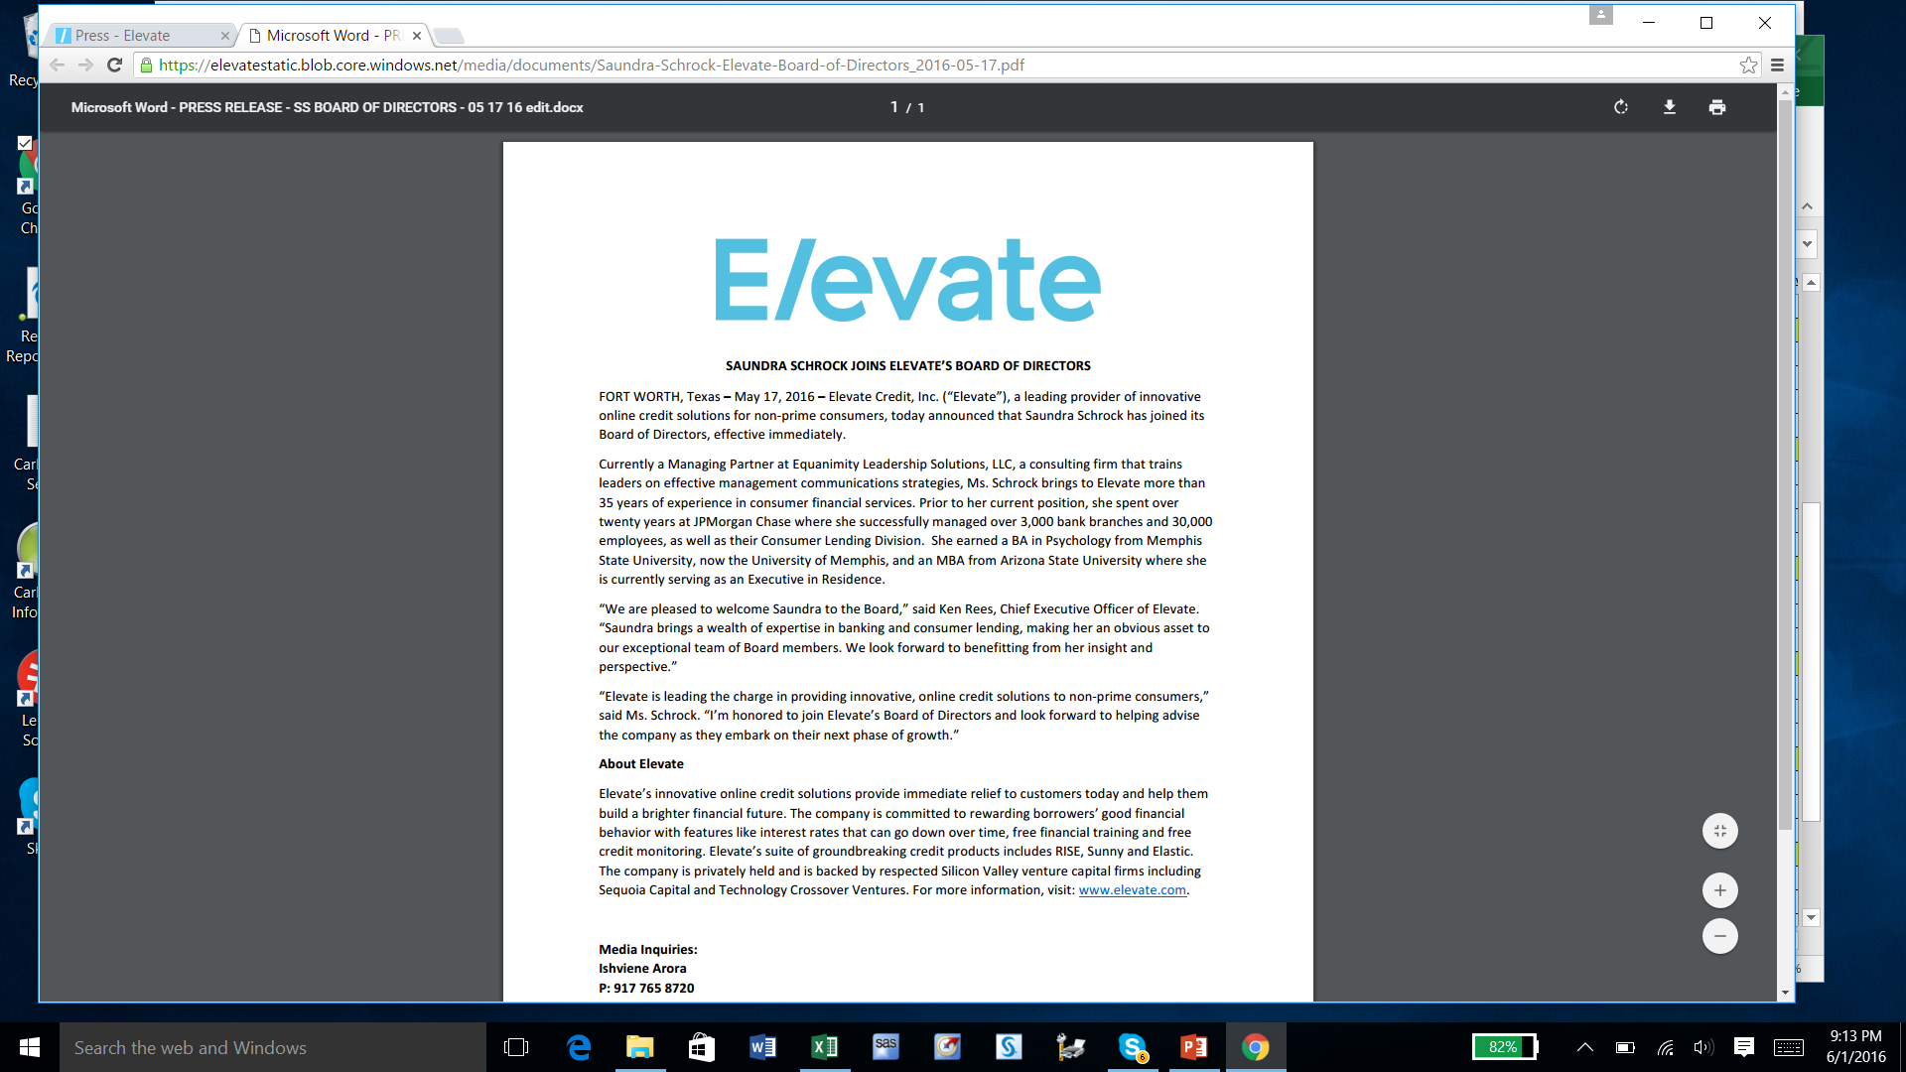
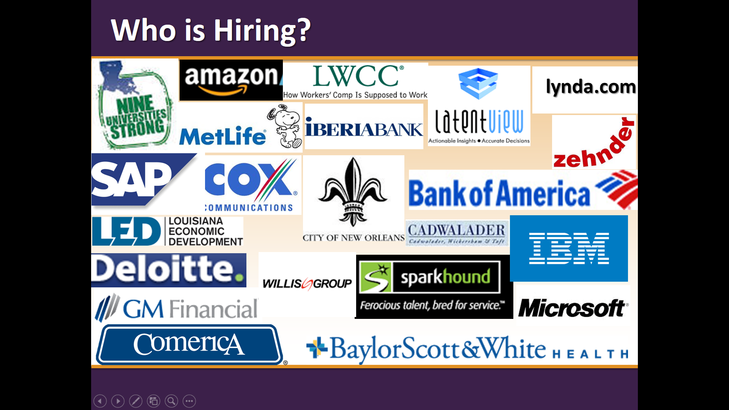
Who is Hiring?

Slide 11

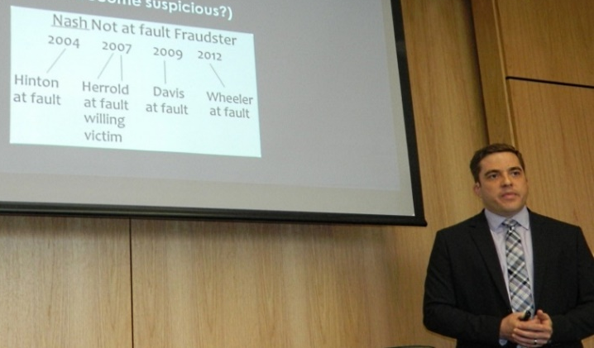
Sponsored Projects
Sponsored
Human Trafficking:
● Key players, movements, and recommend strategies

Slide 12

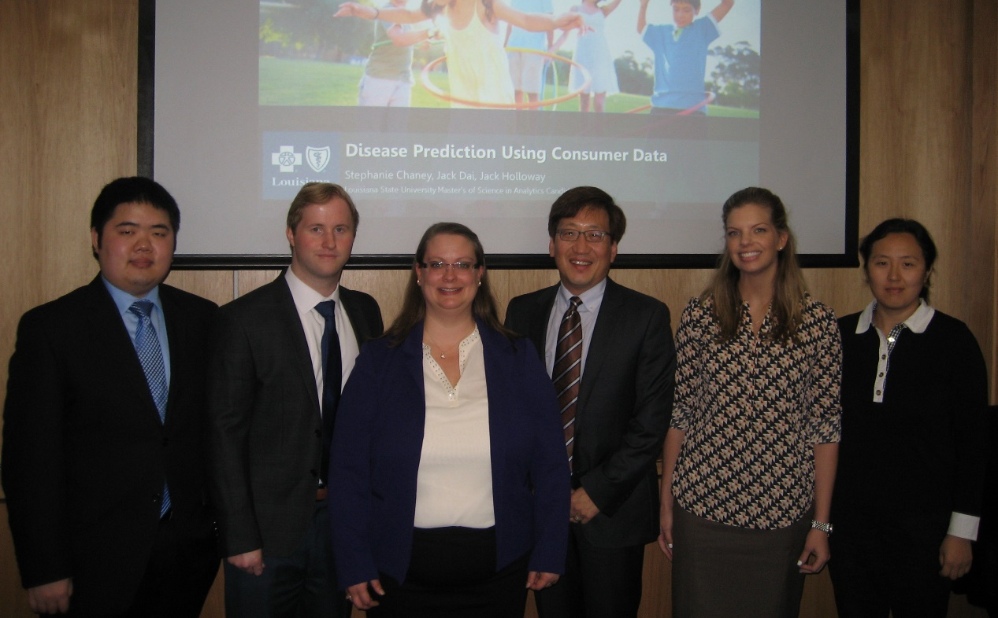
Sponsored Projects
Sponsored
Determining Risk
Of Chronic Diseases
Using
Consumer Data

Slide 13
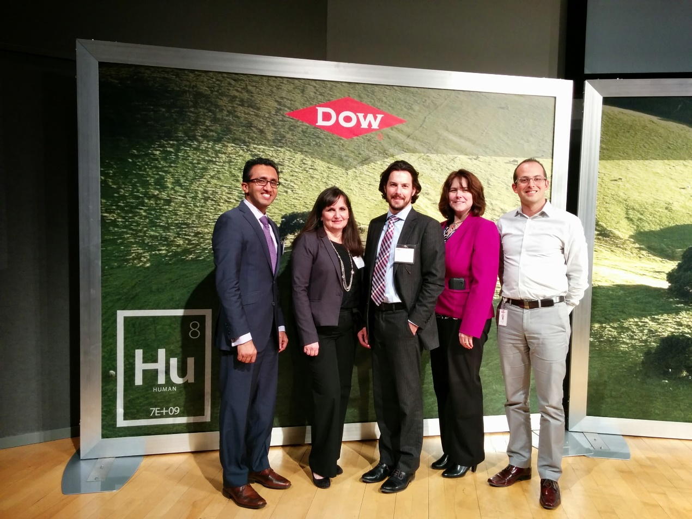
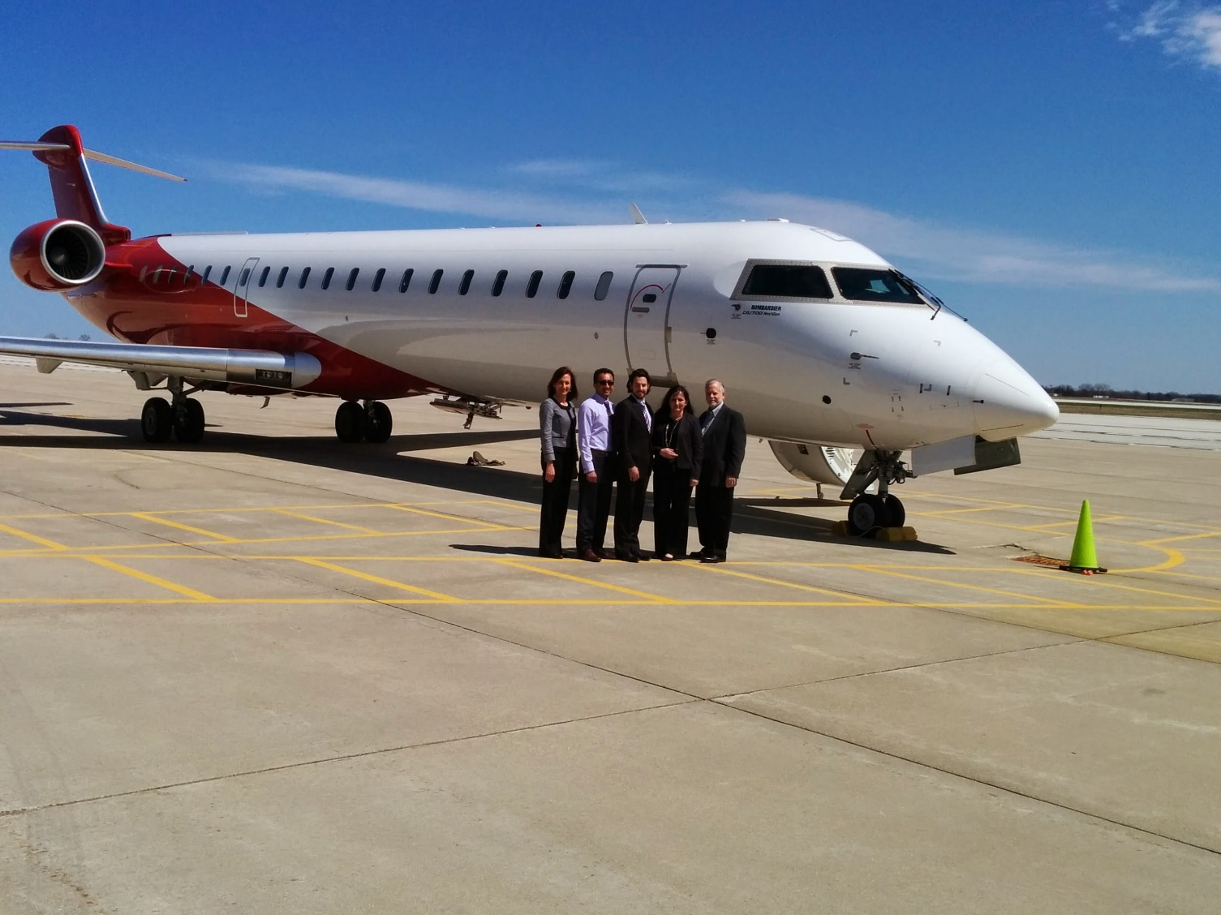
Sponsored Projects
Sponsored
If we tell you about
this project, we’ll…

Slide 14
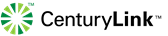
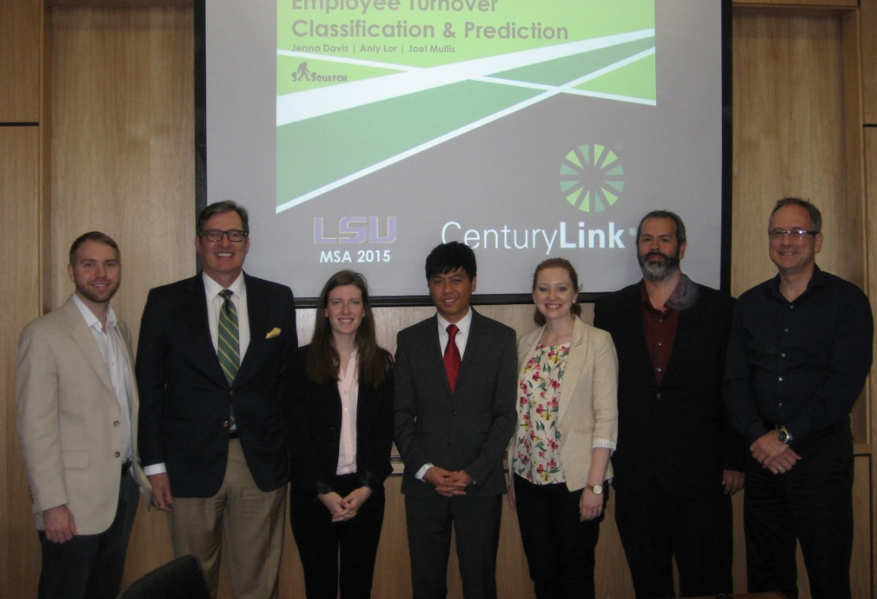
Sponsored Projects
Sponsored
Call Center Analysis:
Evaluate technical calls
Suggest alternative responses

Slide 15

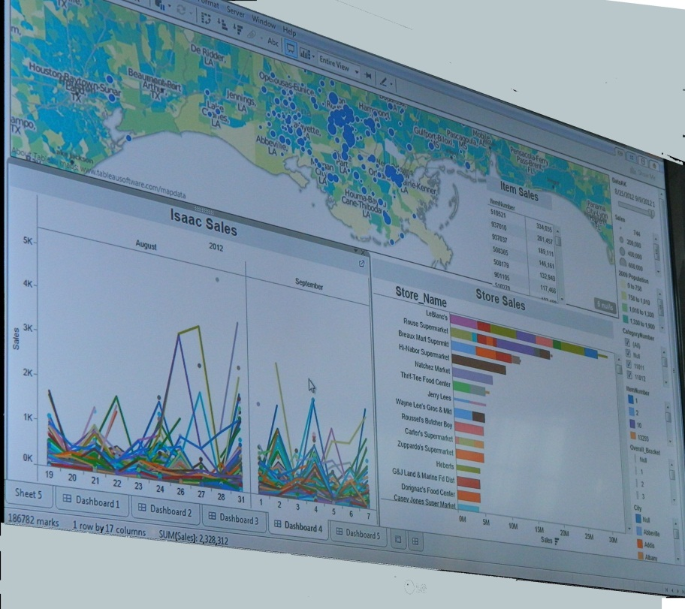
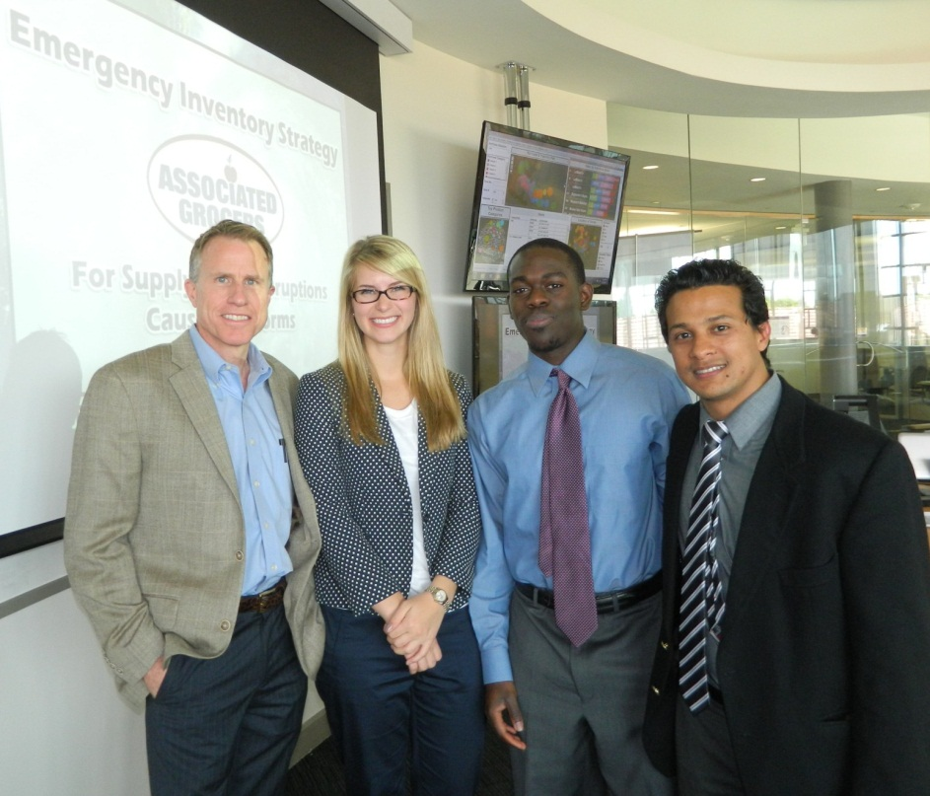
Sponsored Projects
Hurricane Preparedness:
· Using historical sales data to
right-size store inventories
hurricane landfall

Slide 16

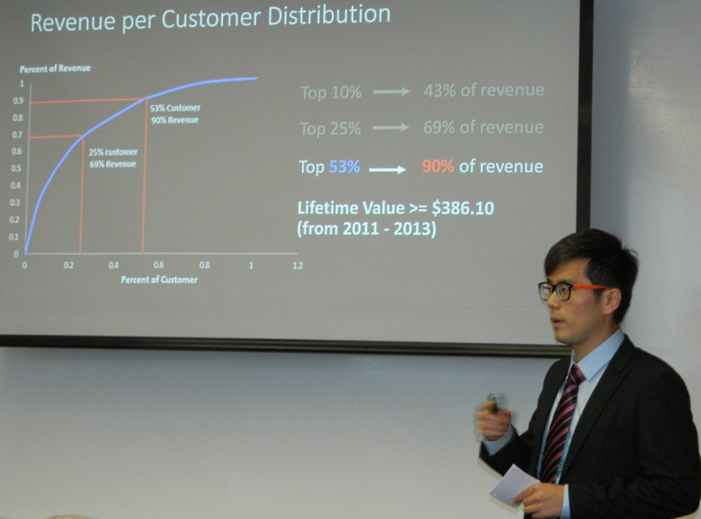
Sponsored Projects
Optimum Maintenance Schedule: Maximizing garment output and machine longevity
· Analyze maintenance records
· Forecast preventive maintenance

Slide 17
Graduate Certificate in Analytics
Graduate degree from Ourso College of Business
Participate in graduation
Less rigorous version of the full-time degree
12 credit-hour program – completed in 9 months
4 course curriculum (descriptive, predictive, prescriptive, and a practicum project)
Application deadline: August 1, 2018
Classes start: August 15, 2018

Slide 18
Application Process
Apply online through the LSU Graduate School website - www.lsu.edu/graduateschool/apply
Select program:
Information Systems and Decision Sciences – Analytics - MS
Submit transcripts, 3 recommendations, statement of purpose & official test scores
Accepting Applications NOW!
International deadline: Dec. 15, 2017
Domestic deadline: March 31, 2018

Slide 19
Contact Information:
James Davis, Director: jamesdavis@lsu.edu
225-892-0230 (c)
Gabrielle LeBoeuf: gleboe2@lsu.edu
Do not wait. APPLY NOW!
Thank You!

